Slide 1

Priority Areas for Reforestation
Martin Sanchez (October 28, 2018)
Presented to:
Thinking Machines
Data Science
Analyzing vulnerability as a function of impact and adaptative capacity in order to classify
priority areas for reforestation on regions affected by Typhoon Odette.
Presented by:
Mark Anthony A. Cabanlit
Notes:
Martin Sanchez (October 28, 2018)
https://unsplash.com/photos/ML6kHR--Uys

Slide 2
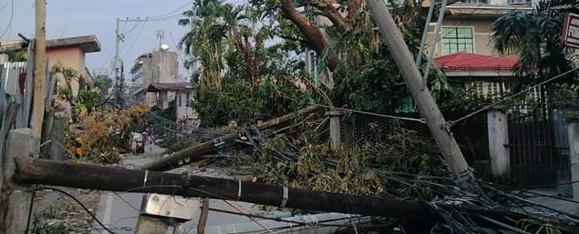
Introduction
Viviana Rishe (August 9, 2018)
Mark Cabanlit (2021)
On 16 December 2021, Typhoon Rai (local name Odette) brought torrential rains, violent winds, landslides, and storm surges in the provinces of Surigao del Norte and Dinagat Islands in Mindanao, in five provinces of Visayas, and in the island of Palawan in Luzon before it exited the Philippine area of responsibility on 17 December. –UNHCR
Notes:
Viviana Rishe (August 9, 2018)
https://unsplash.com/photos/QAFp7YhT-4Q

Slide 3
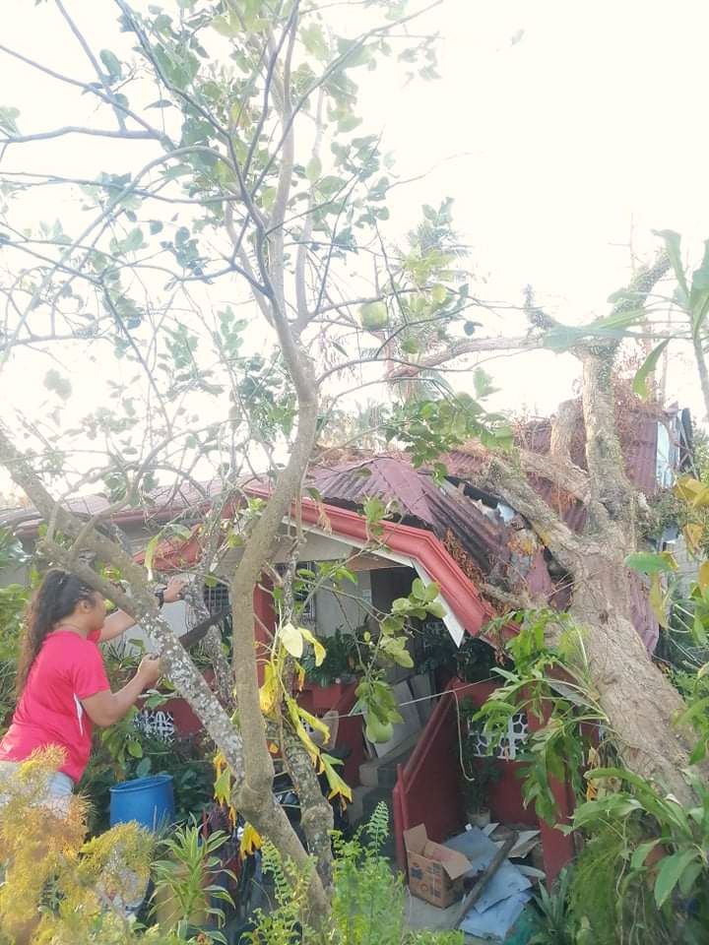
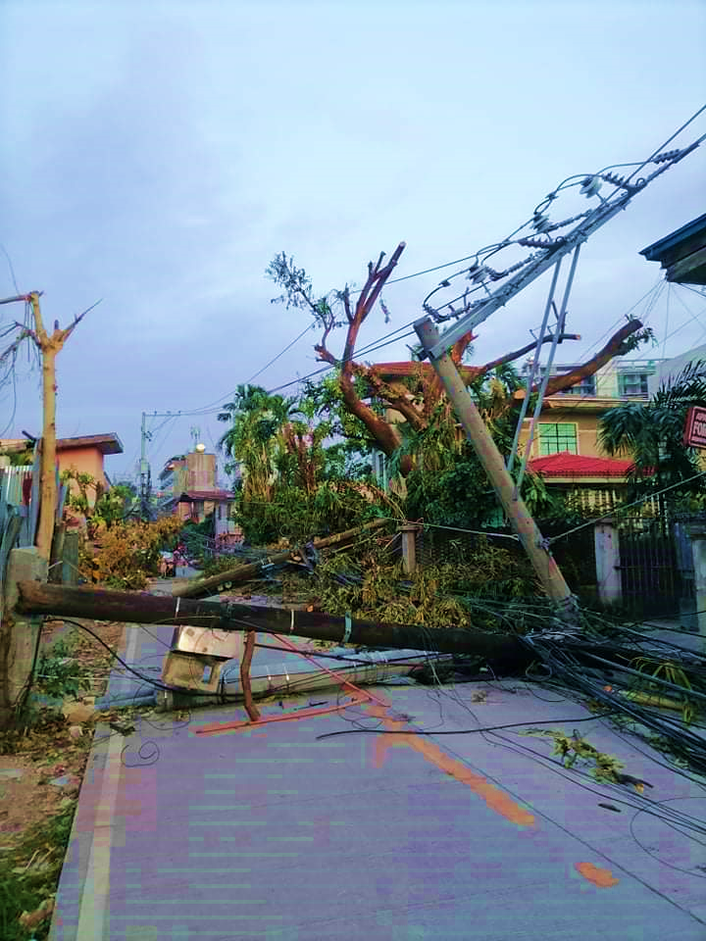
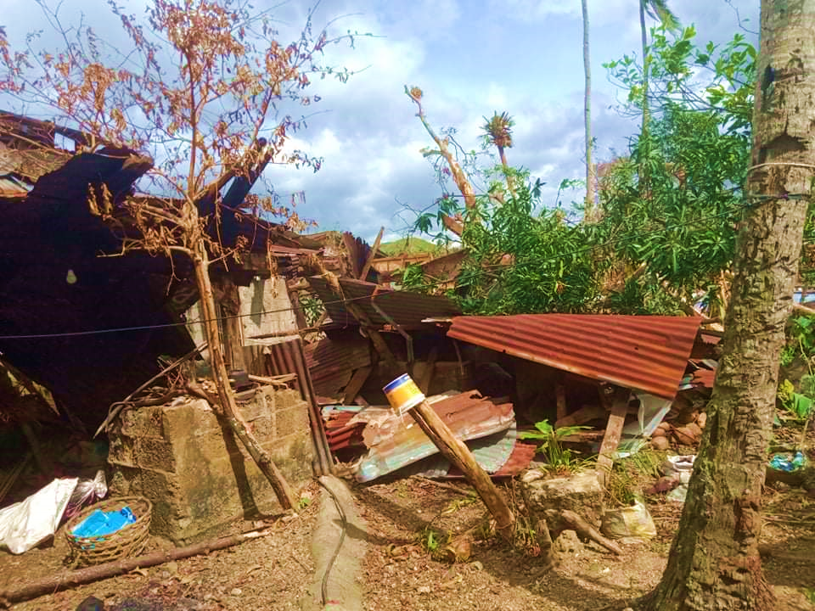
Super Typhoon Odette (Rai)
Almost 5 months after the typhoon, I am glad to say that we are slowly recovering from the damages brought about by the typhoon.
According to NDRRMC, there have been 2,276,535 affected families, 405 deaths, and almost 2M damaged houses.
A lot has changed most specially in the rural areas, almost no shade can be seen since most trees have been toppled down by the Typhoon and that includes the tree that destroyed our house.
Although a few of the houses have already been repaired within the span of a few months, unfortunately other factors such as trees would require more time to recover.
Mark Cabanlit (2021)

Slide 4
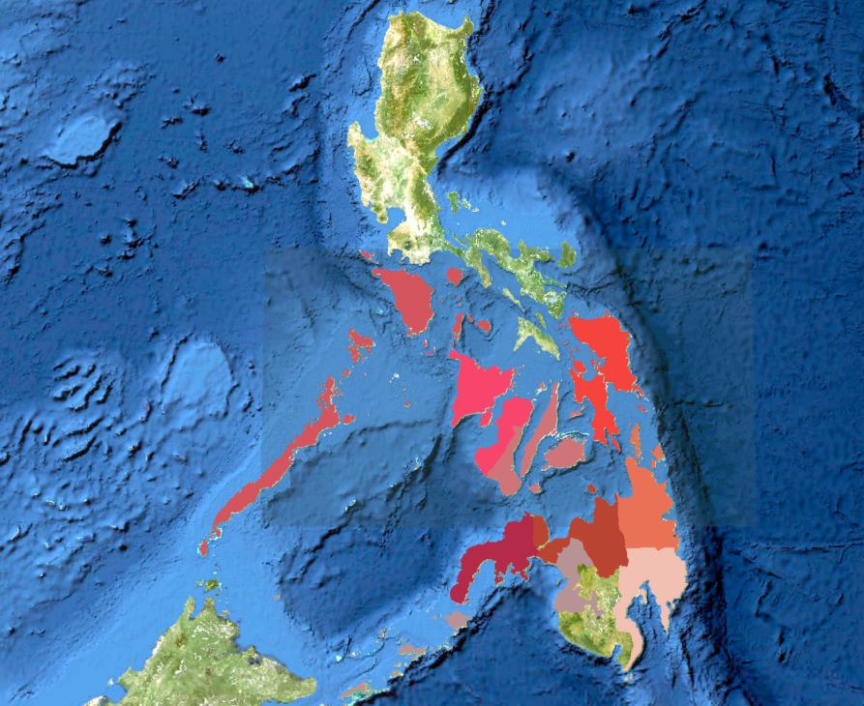
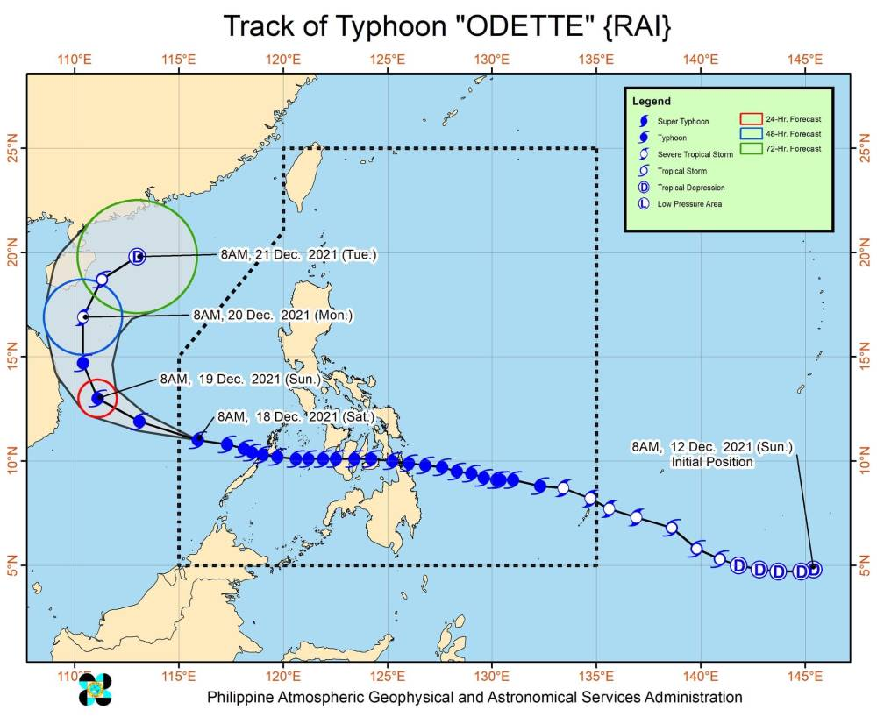
Study Area
The image on the left shows the path of Typhoon Rai when it passed the Philippines.

Slide 5
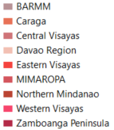
Study Area
The image on the left shows the path of Typhoon Rai when it passed the Philippines.
The regions that were affected includes: BARMM, CARAGA, Central Visayas, Eastern Visayas, Western Visayas, Zamboanga Peninsula, Northern Mindanao and Davao Region.

Slide 6
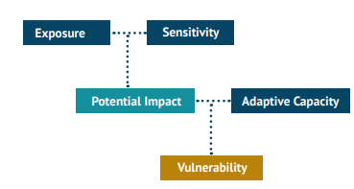
Identifying Priority Areas
The Intergovernmental Panel on Climate Change (IPCC; 2001) defines Vulnerability as “the degree to which a system is susceptible to, or unable to cope with, adverse effects of climate change, including climate variability and extremes.” It is a function of (1) the degree of the system’s Exposure to climate hazards; (2) its Sensitivity to such hazards; and (3) its Adaptive Capacity (IPCC, 2001)
For this particular use case, the impact has already been experienced so we will be tailoring our factors towards Impact instead of Potential Impact which is a function of Exposure and Sensitivity.
Adapted from Alino et.al (2013) guidebook on Vulnerability Assessment Tools for Coastal Ecosystems

Slide 7
Identifying Priority Areas
The Intergovernmental Panel on Climate Change (IPCC; 2001) defines Vulnerability as “the degree to which a system is susceptible to, or unable to cope with, adverse effects of climate change, including climate variability and extremes.” It is a function of (1) the degree of the system’s Exposure to climate hazards; (2) its Sensitivity to such hazards; and (3) its Adaptive Capacity (IPCC, 2001)
For this particular use case, the impact has already been experienced so we will be tailoring our factors towards Impact instead of Potential Impact which is a function of Exposure and Sensitivity.
Impact
Adaptive Capacity
Vulnerable Sites / Priority Areas
Adapted from Alino et.al (2013) guidebook on Vulnerability Assessment Tools for Coastal Ecosystems

Slide 8
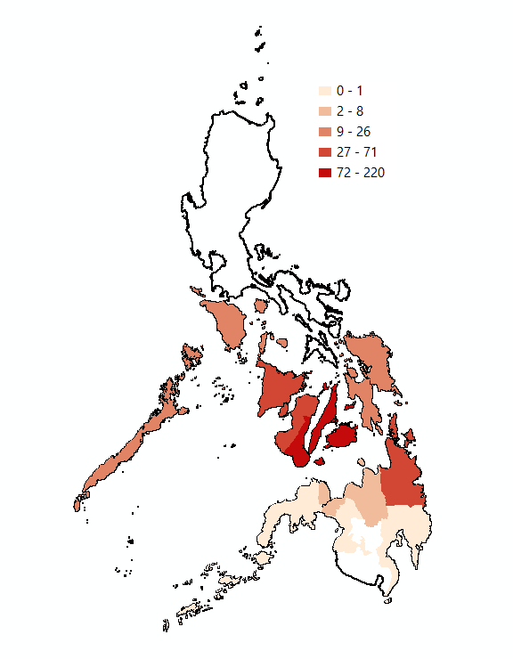
Impact
Here are the layers that are under the Impact factor of our analysis:
Number of Deaths

Slide 9
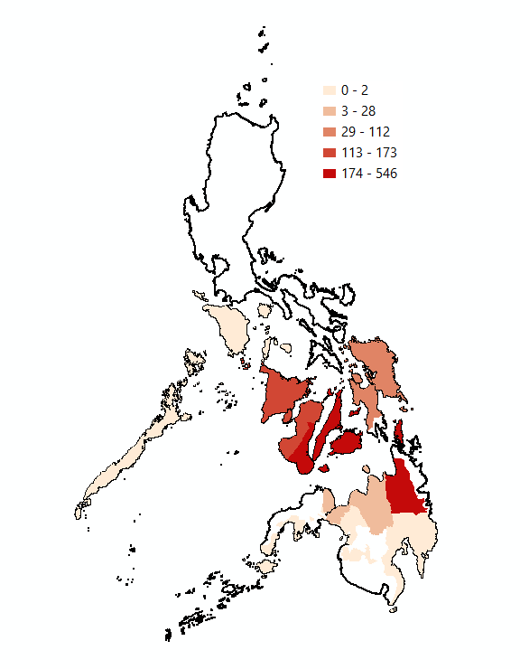
Impact
Here are the layers that are under the Impact factor of our analysis:
Number of Deaths
Number of Injuries

Slide 10
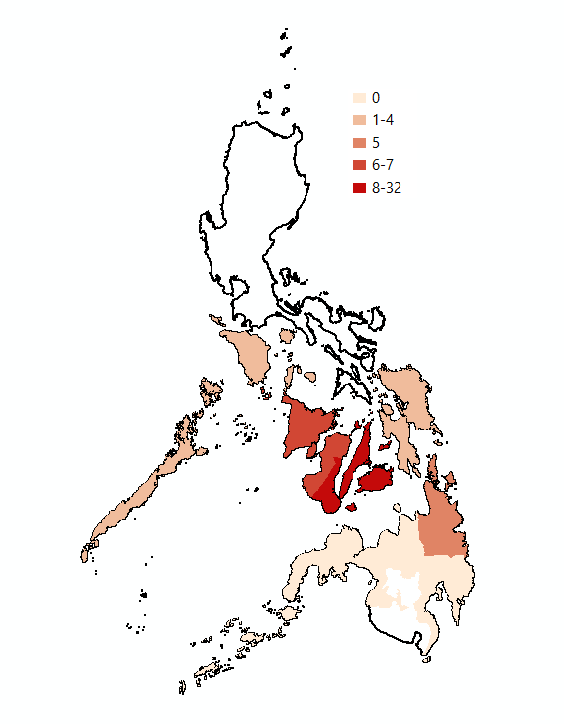
Impact
Here are the layers that are under the Impact factor of our analysis:
Number of Deaths
Number of Injuries
Number of Missing People

Slide 11
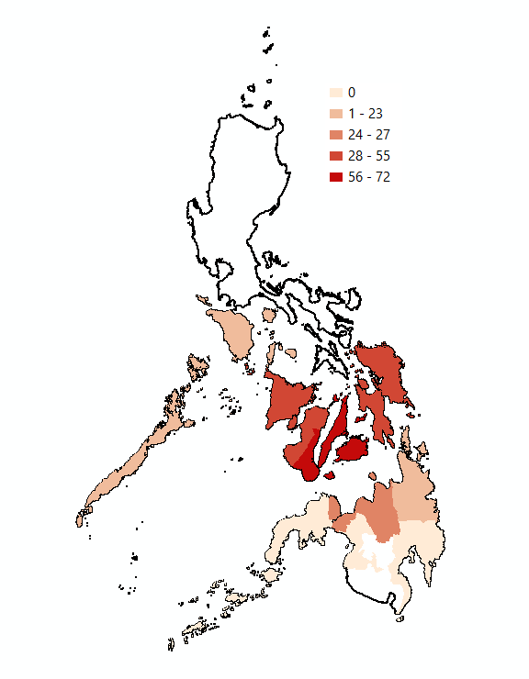
Impact
Here are the layers that are under the Impact factor of our analysis:
Number of Deaths
Number of Injuries
Number of Missing People
Non-passable Roads

Slide 12
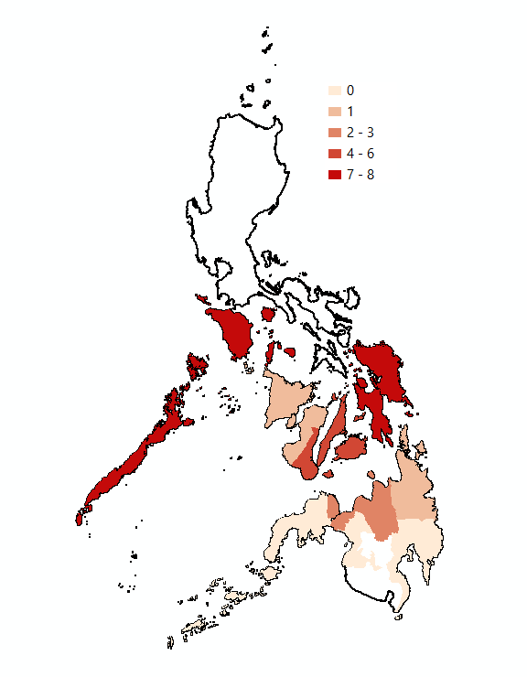
Impact
Here are the layers that are under the Impact factor of our analysis:
Number of Deaths
Number of Injuries
Number of Missing People
Non-passable Roads
Non-passable Bridges

Slide 13
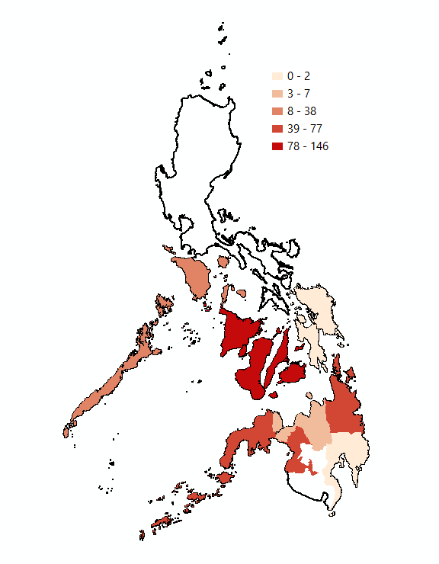
Impact
Here are the layers that are under the Impact factor of our analysis:
Number of Deaths
Damaged Communication Lines
Number of Injuries
Number of Missing People
Non-passable Roads
Non-passable Bridges

Slide 14
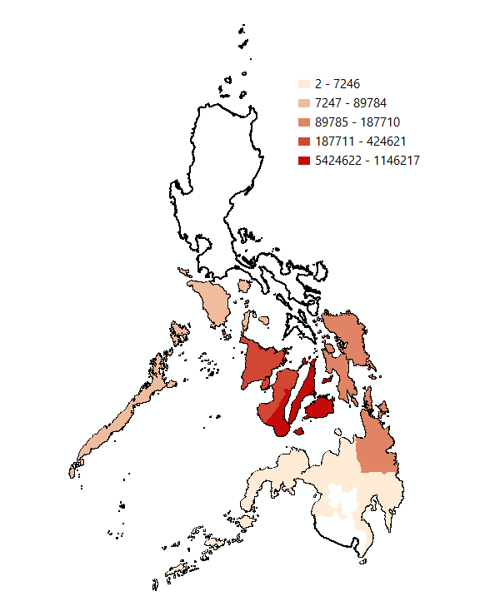
Impact
Here are the layers that are under the Impact factor of our analysis:
Number of Deaths
Damaged Communication Lines
Number of Injuries
Number of Damaged Houses
Number of Missing People
Non-passable Roads
Non-passable Bridges

Slide 15
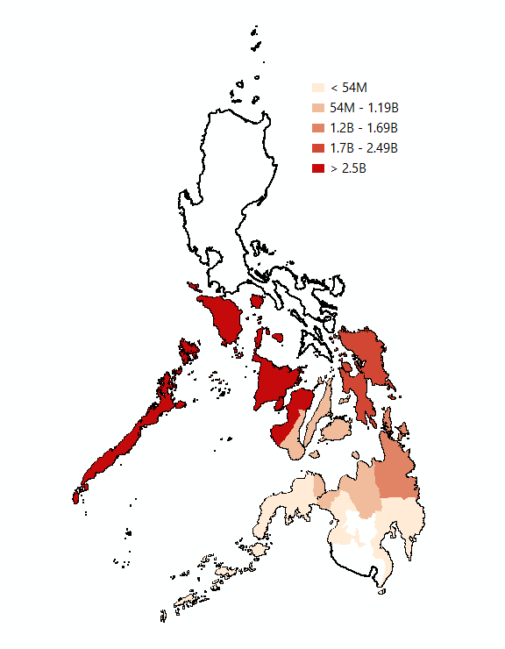
Impact
Here are the layers that are under the Impact factor of our analysis:
Number of Deaths
Damaged Communication Lines
Number of Injuries
Number of Damaged Houses
Number of Missing People
Damage to Agriculture
Non-passable Roads
Non-passable Bridges

Slide 16
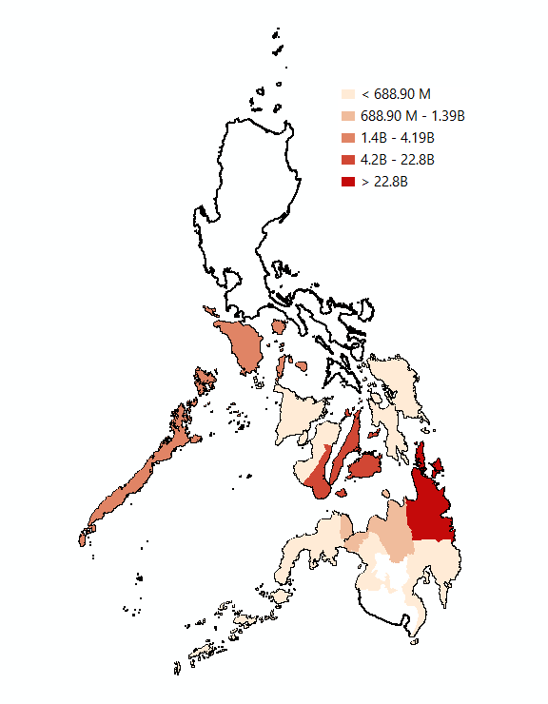
Impact
Here are the layers that are under the Impact factor of our analysis:
Number of Deaths
Damaged Communication Lines
Number of Injuries
Number of Damaged Houses
Number of Missing People
Damage to Agriculture
Non-passable Roads
Damage to Infrastructure
Non-passable Bridges

Slide 17
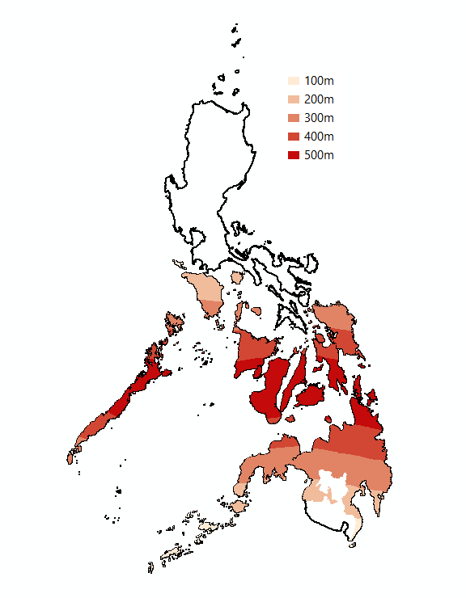
Impact
Here are the layers that are under the Impact factor of our analysis:
Number of Deaths
Damaged Communication Lines
Number of Injuries
Number of Damaged Houses
Number of Missing People
Damage to Agriculture
Non-passable Roads
Damage to Infrastructure
Non-passable Bridges
Distance from Path of Typhoon

Slide 18
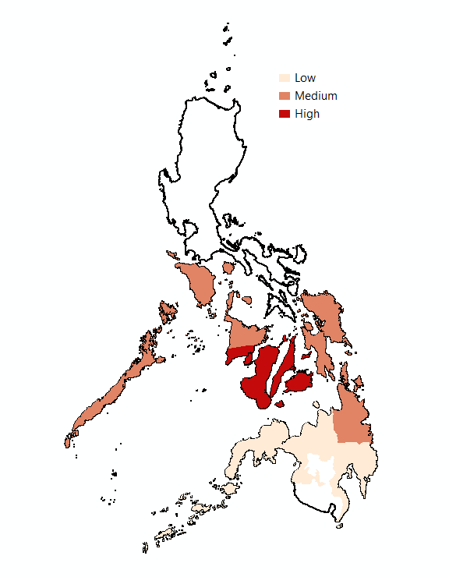
Impact
Here are the layers that are under the Impact factor of our analysis:
Number of Deaths
Damaged Communication Lines
Number of Injuries
Number of Damaged Houses
Number of Missing People
Damage to Agriculture
Non-passable Roads
Damage to Infrastructure
Non-passable Bridges
Distance from Path of Typhoon
Converted Impact Layer
This layer is a combination of all the data above, which was then normalized and categorized into Low Impact, Medium Impact and High Impact.

Slide 19
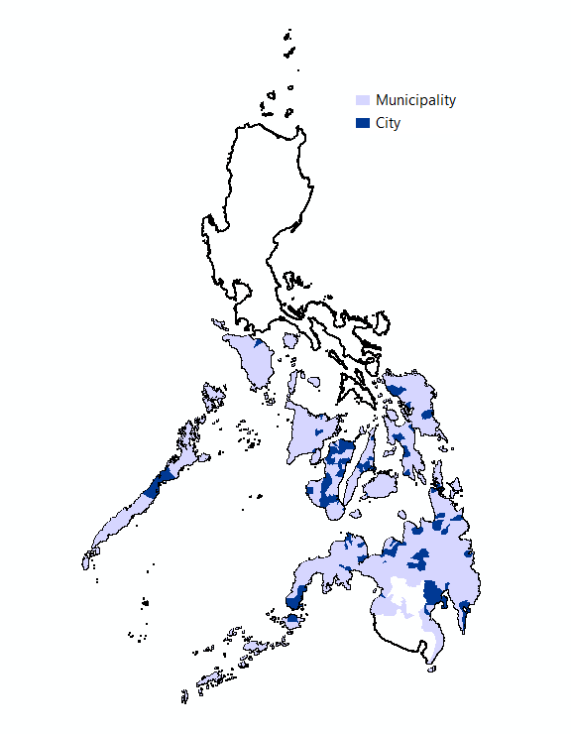
Adaptive Capacity
Here are the layers that are under the Adaptive Capacity factor of our analysis:
City / Municipality

Slide 20
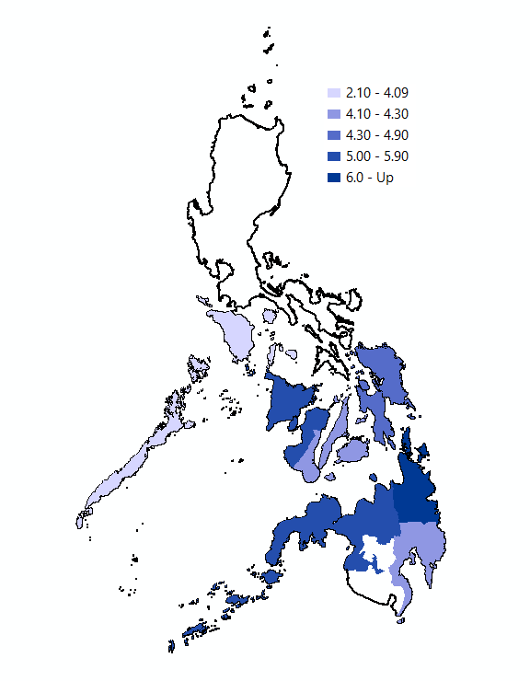
Adaptive Capacity
Here are the layers that are under the Adaptive Capacity factor of our analysis:
City / Municipality
Regional GDP

Slide 21
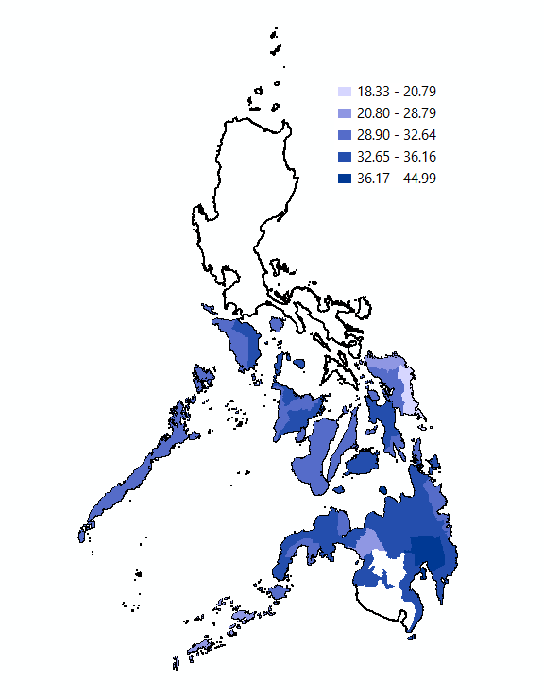
Adaptive Capacity
Here are the layers that are under the Adaptive Capacity factor of our analysis:
City / Municipality
Regional GDP
Provincial 4 Pillars

Slide 22
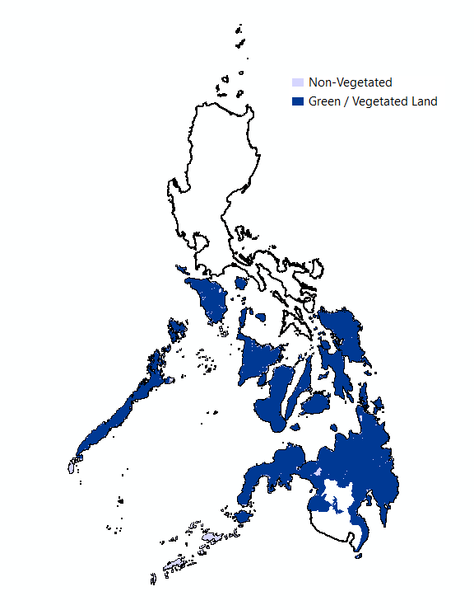
Adaptive Capacity
Here are the layers that are under the Adaptive Capacity factor of our analysis:
City / Municipality
Regional GDP
Provincial 4 Pillars
Land Cover

Slide 23
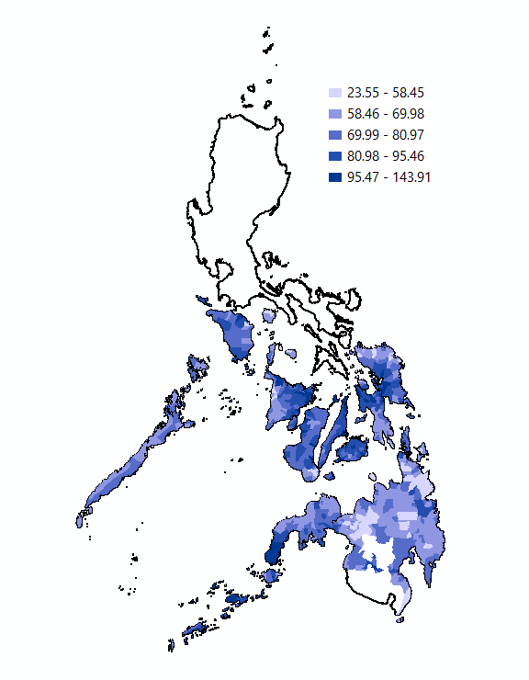
Adaptive Capacity
Here are the layers that are under the Adaptive Capacity factor of our analysis:
City / Municipality
Green Band
Regional GDP
Provincial 4 Pillars
Land Cover

Slide 24
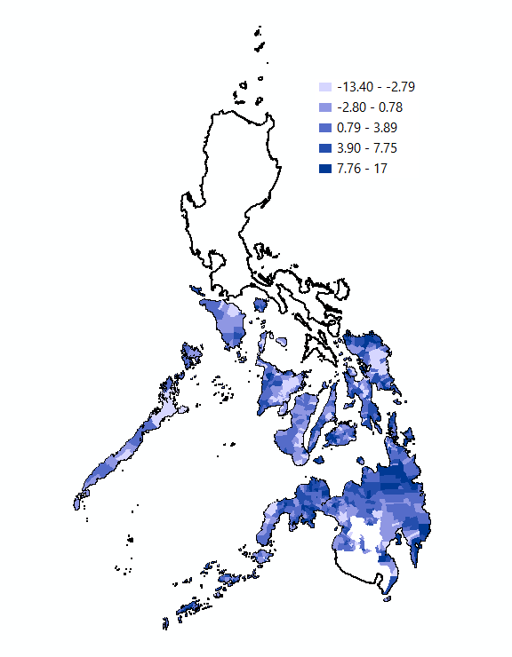
Adaptive Capacity
Here are the layers that are under the Adaptive Capacity factor of our analysis:
City / Municipality
Green Band
Regional GDP
Change in Global Tree Cover
Provincial 4 Pillars
Land Cover

Slide 25

Adaptive Capacity
Here are the layers that are under the Adaptive Capacity factor of our analysis:
City / Municipality
Green Band
Regional GDP
Change in Global Tree Cover
Provincial 4 Pillars
Change in Global Biomass Carbon
Land Cover

Slide 26
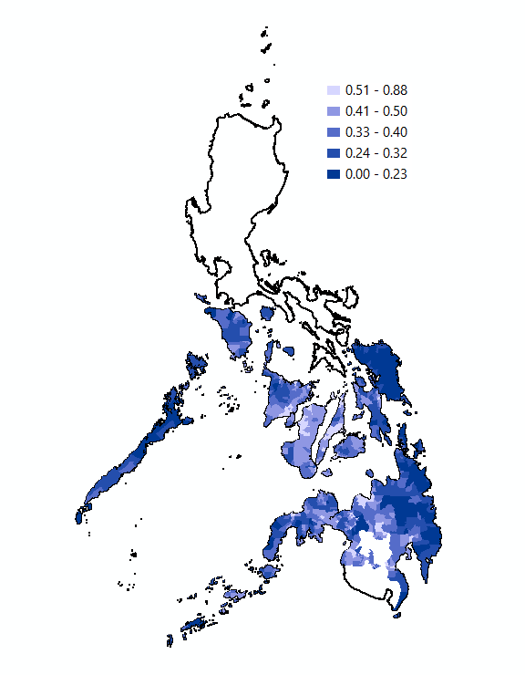
Adaptive Capacity
Here are the layers that are under the Adaptive Capacity factor of our analysis:
City / Municipality
Green Band
Regional GDP
Change in Global Tree Cover
Provincial 4 Pillars
Change in Global Biomass Carbon
Land Cover
Global Human Modification

Slide 27
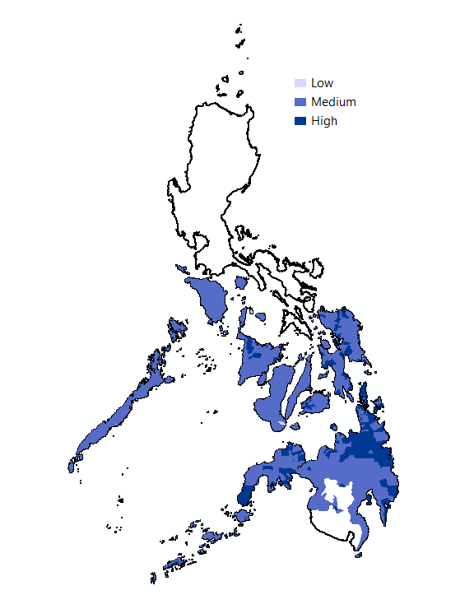
Adaptive Capacity
Here are the layers that are under the Adaptive Capacity factor of our analysis:
City / Municipality
Green Band
Regional GDP
Change in Global Tree Cover
Provincial 4 Pillars
Change in Global Biomass Carbon
Land Cover
Global Human Modification
Converted Adaptive Capacity Layer
This layer is a combination of all the data above, which was then normalized and categorized into Low Adaptive Capacity, Medium Adaptive Capacity and High Adaptive Capacity.

Slide 28
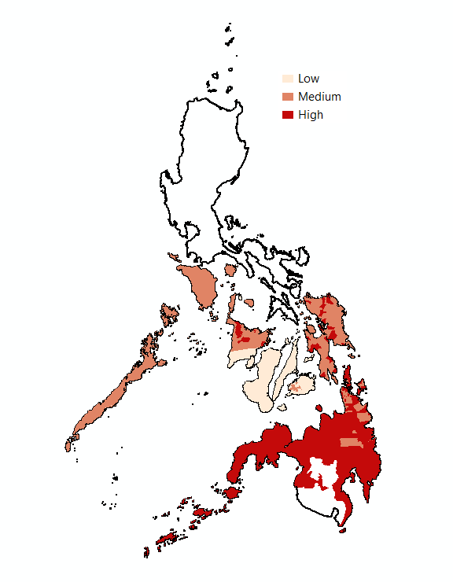
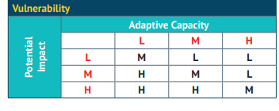
Potential Sites
Candidate sites for reforestation can be estimated by cross referencing impact and adaptive capacity layers as per the table below.

Slide 29

Potential Sites
!
Laoang
!
Makato
Tabango
!
!
Dapa
!
Sagay
!
Candidate sites for reforestation can be estimated by cross referencing impact and adaptive capacity layers as per the table below.

Slide 30

Scope and Limitations
Further information about the data can be found on the submitted data set guide file.
Only limited analysis has been made on the number of factors and the factors involved due to the time constraint.
Most adaptive capacity values are geared towards forest cover in order to have an estimate or partial representation of the environment’s ability to adapt.
Most impact values are based on the report from NDRRMC and the quality and the accuracy of the datasets as well as the overlay analysis has not been analyzed for possible errors
NDVI can be used but due to the large nature of the study area, the presenter wasn’t able to download it since the drive space cannot contain the NDVI pre and post typhoon.
Guillaume de Germain (February 22, 2016)
Notes:
Guillaume de Germain (February 22, 2016)
https://unsplash.com/photos/h1itWfWeQM4

Slide 31
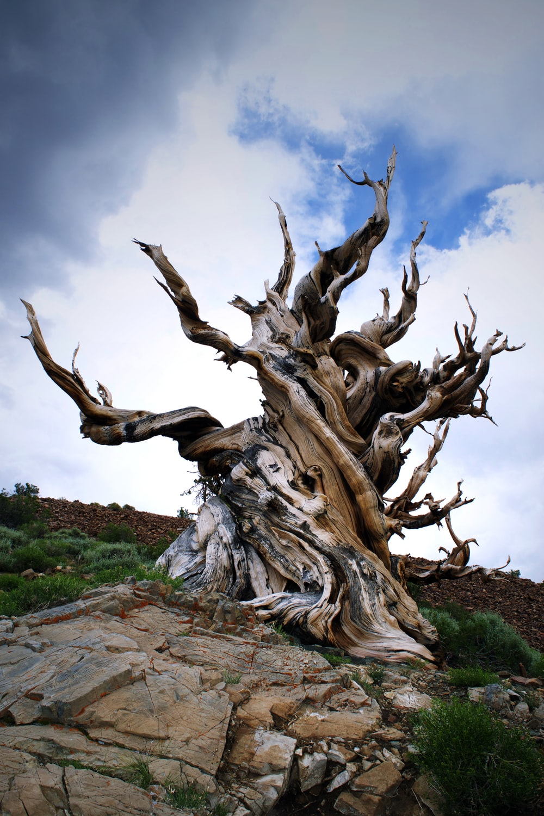
Recommendations
Educate people on how to inspect the health of the tree. For example, checking for weakened structural integrity. Most of the structural damages in homes were caused by strong winds and as well as trees falling into the houses.
Normalized Difference Vegetation Index can be a useful layer in this analysis (personnel may need larger cloud storage).
On the ground data and as well as community interviews can be a good input into the analysis and would somehow supplement and validate the analysis from remotely sensed data.
Tree species dataset can be helpful in the analysis.
Notes:
Juvian Duff ( April 6, 2019)
https://unsplash.com/photos/x_mdcjGHnUI

